Slide 1
Structural Modeling and Class Design Session 19
Course : COMP6056
Effective Period : September 2021

Slide 2
Sub Topics
Introduction
Structural Models
Object Identification
CRC Cards
Class Diagram
Creating Structural Model using CRC Cards

Slide 3
These slides have been adapted from: Alan Dennis, Barbara Haley Wixom, David Tegarden (2015). Systems Analysis and Design_ An Object-Oriented Approach with UML, 5th ed. ISBN: 978-1-118-80467-4 Chapter 5
Acknowledgement

Slide 4
Learning Objectives
At the end of this lecture, students are able to:
LO3: To analyze the requirement of a system
LO4: To solve a system by using class diagram representation

Slide 5
Introduction
A structural, or conceptual, model describes the structure of the objects that support the business processes in an organization.
During analysis, analysts create business process and functional models to represent how the business system will behave.
At the same time, analysts need to understand the information that is used and created by the business system (e.g., customer information, order information)
A. Dennis et al.,(2015). Systems Analysis and Design An Object-Oriented Approach with UML, 5th ed. ISBN: 978-1-118-80467-4

Slide 6
Structural Models
Structural models represent the things, ideas, or concepts contained in the domain of the problem.
They also allow the representation of the relationships among the things, ideas, or concepts.
By creating a structural model of the problem domain, the analyst creates the vocabulary necessary for the analyst and users to communicate effectively
A. Dennis et al.,(2015). Systems Analysis and Design An Object-Oriented Approach with UML, 5th ed. ISBN: 978-1-118-80467-4

Slide 7
Classes, Attributes, and Operations
Class
A general template used to create specific instances, or objects, in the problem domain.
All objects of a given class are identical in structure and behavior but contain different data in their attributes.
There are two types of classes:
Concrete and abstract.
When analysts describes the application domain classes, they are referring to concrete classes; that is, concrete classes are used to create objects.
Abstract classes do not actually exist in the real world; they are simply useful abstractions.
A. Dennis et al.,(2015). Systems Analysis and Design An Object-Oriented Approach with UML, 5th ed. ISBN: 978-1-118-80467-4

Slide 8
Classes, Attributes, and Operations
Attributes
Represents a piece of information that is relevant to the description of the class within the application domain
Operation or service
Behavior of an analysis class
Later the operations are converted to methods
A. Dennis et al.,(2015). Systems Analysis and Design An Object-Oriented Approach with UML, 5th ed. ISBN: 978-1-118-80467-4

Slide 9
Relationships
Types of relationships:
Association relationship
Aggregation & Composition relationship
Generalization relationship
Dependency relationship
A. Dennis et al.,(2015). Systems Analysis and Design An Object-Oriented Approach with UML, 5th ed. ISBN: 978-1-118-80467-4

Slide 10
Relationships
Association Relationship
These relationships are usually a weaker form of the aggregation relationship.
Association is a general binary relationship that describes an activity between two classes
Association between two classes is required when the classes need to interact or communicate for the program to achieve its purpose
Association are also called links
A. Dennis et al.,(2015). Systems Analysis and Design An Object-Oriented Approach with UML, 5th ed. ISBN: 978-1-118-80467-4

Slide 11
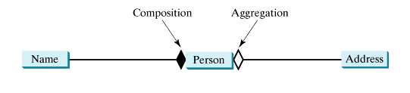
Relationships
Aggregation Relationship
All aggregation relationships relate parts to wholes or assemblies.
‘a-part-of’ or ‘has-parts’ semantic relationship
For example, a door is a-part-of a car, an employee is a-part-of a department, or a department is a-part-of an organization.
Like the generalization relationship, aggregation relationships can be combined into aggregation hierarchies. For example, a piston is a-part-of an engine, and an engine is a-part-of a car

Slide 12
Relationships
Generalization Relationship
Enables the analyst to create classes that inherit attributes and operations of other classes.
The analyst creates a superclass that contains basic attributes and operations that will be used in several subclasses
A. Dennis et al.,(2015). Systems Analysis and Design An Object-Oriented Approach with UML, 5th ed. ISBN: 978-1-118-80467-4

Slide 13
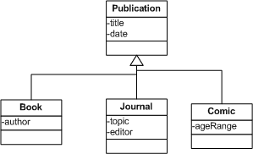
Relationships
There are various ways of describing the inheritance relationship:
A specialized class inherits from a general class
A subclass inherits from a superclass
A child class inherits from a parent class
A derived class inherits from a base class
A. Dennis et al.,(2015). Systems Analysis and Design An Object-Oriented Approach with UML, 5th ed. ISBN: 978-1-118-80467-4

Slide 14

Relationships
Dependency Relationship
A dependency describes a relationship between two classes where one (called client) uses the other (called supplier).
In UML, draw a dashed line with an arrow from the client class to the supplier class.
For example, The Calendar class uses Date because you can set a calendar with a specified Date object.
The relationship between Calendar and Date can be described using dependency, as shown

Slide 15
Object Identification
Textual Analysis
Reviewing the use-case diagrams and examining the text in the use-case descriptions to identify potential objects, attributes, operations, and relationships
Brainstorming
A process that a set of individuals sitting around a table suggest potential classes that could be useful for the problem under consideration
Common Object Lists
A list of objects common to the business domain of the system.
Several categories of objects have been found to help the analyst in creating the list, such as physical or tangible things, incidents, roles, and interactions.
Analysts should first look for physical, or tangible, things in the business domain
A. Dennis et al.,(2015). Systems Analysis and Design An Object-Oriented Approach with UML, 5th ed. ISBN: 978-1-118-80467-4

Slide 16
Characteristic of Object Orientation
Encapsulation and Information Hiding
Polymorphism and Dynamic Binding
Inheritance
A. Dennis et al.,(2015). Systems Analysis and Design An Object-Oriented Approach with UML, 5th ed. ISBN: 978-1-118-80467-4

Slide 17
Characteristic of Object Orientation
Encapsulation and Information Hiding
Encapsulation is the mechanism that combines the processes and data into a single object.
Information hiding suggests that only the information required to use an object be available outside the object
A. Dennis et al.,(2015). Systems Analysis and Design An Object-Oriented Approach with UML, 5th ed. ISBN: 978-1-118-80467-4

Slide 18
Characteristic of Object Orientation
Polymorphism and Dynamic Binding
Polymorphism means having the ability to take several forms
Dynamic binding refers to the ability of object-oriented systems to defer the data typing of objects to run time
A. Dennis et al.,(2015). Systems Analysis and Design An Object-Oriented Approach with UML, 5th ed. ISBN: 978-1-118-80467-4

Slide 19
Characteristic of Object Orientation
Inheritance
Inheritance allows developers to defi ne classes incrementally by reusing classes defi ned previously as the basis for new classes
A. Dennis et al.,(2015). Systems Analysis and Design An Object-Oriented Approach with UML, 5th ed. ISBN: 978-1-118-80467-4

Slide 20
Object Identification
Patterns
A pattern is simply a useful group of collaborating classes that provide a solution to a commonly occurring problem.
Because patterns provide a solution to commonly occurring problems, they are reusable.
A. Dennis et al.,(2015). Systems Analysis and Design An Object-Oriented Approach with UML, 5th ed. ISBN: 978-1-118-80467-4

Slide 21
CRC Cards
CRC (Class–Responsibility–Collaboration) cards are used to document the responsibilities and collaborations of a class
Responsibilities and Collaborations
Responsibilities of a class can be broken into two separate types: knowing and doing.
Knowing responsibilities are those things that an instance of a class must be capable of knowing
Doing responsibilities are those things that an instance of a class must be capable of doing.
Most use cases involve a set of several classes, not just one class. These classes form collaborations
A. Dennis et al.,(2015). Systems Analysis and Design An Object-Oriented Approach with UML, 5th ed. ISBN: 978-1-118-80467-4

Slide 22
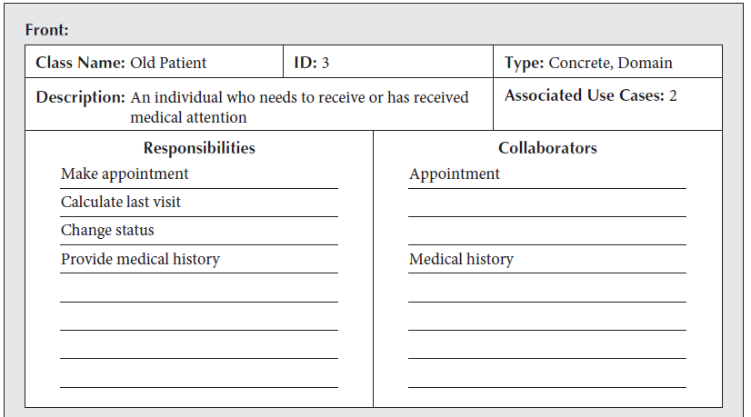
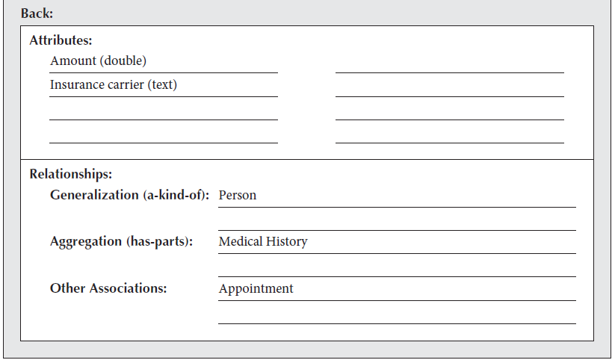
CRC Cards
Elements of a CRC Card
The set of CRC cards contains all the information necessary to build a logical structural model of the problem under investigation
A. Dennis et al.,(2015). Systems Analysis and Design An Object-Oriented Approach with UML, 5th ed. ISBN: 978-1-118-80467-4

Slide 23
findBike(bike#)

Slide 24
getCharges(no.dys)

Slide 25
recordDetails(custID,name, address,tel)

Slide 26
calcTotalPayment()
issueReceipt()

Slide 27
Hire(startDate,no.Days)

Slide 28
Operation
Bike | findBike(bike#) getCharges(no.Days) Bike()
Customer | recordDetails(custID,name,address,tel) customer()
Payment | calcTotalPayment() issueReceipt() Payment()
Hire | Hire(startDate,no.Days)

Slide 29
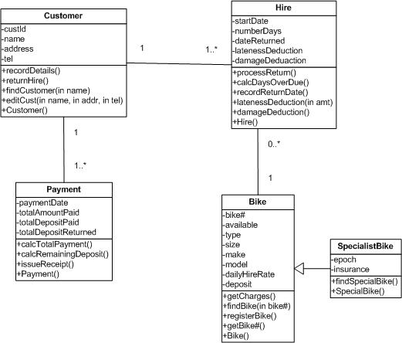
Completed Class Diagram

Slide 30
Class Diagram
Elements of a Class Diagram
Class
stores and manages information in the system
classes refer to the people, places, and things about which the system will capture information
Attribute
Attributes are properties of the class about which we want to capture information
Operations
Operations are actions or functions that a class can perform
A. Dennis et al.,(2015). Systems Analysis and Design An Object-Oriented Approach with UML, 5th ed. ISBN: 978-1-118-80467-4

Slide 31
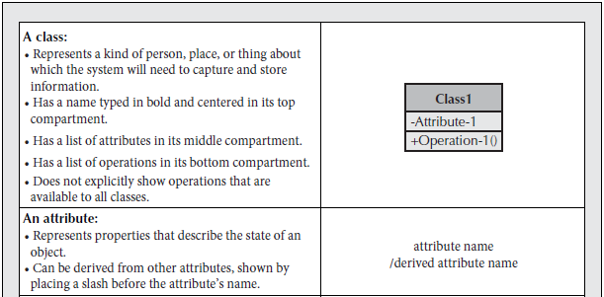
Class Diagram
A. Dennis et al.,(2015). Systems Analysis and Design An Object-Oriented Approach with UML, 5th ed. ISBN: 978-1-118-80467-4

Slide 32
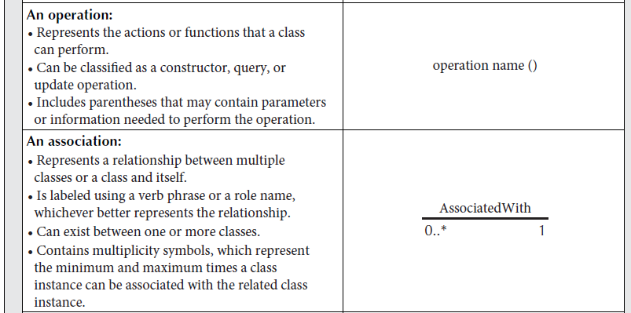
Class Diagram
A. Dennis et al.,(2015). Systems Analysis and Design An Object-Oriented Approach with UML, 5th ed. ISBN: 978-1-118-80467-4

Slide 33
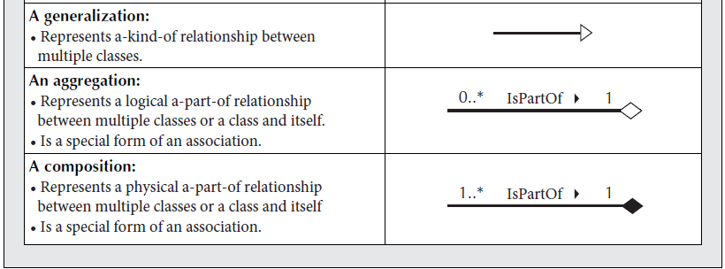
Class Diagram
A. Dennis et al.,(2015). Systems Analysis and Design An Object-Oriented Approach with UML, 5th ed. ISBN: 978-1-118-80467-4

Slide 34
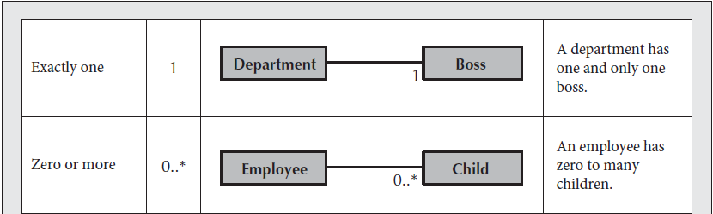
Class Diagram
Relationships
Show the relationships, or associations, that classes have with one another
A class can have a relationship to itself
Relationships have multiplicity, which documents how an instance of an object can be associated with other instances
A. Dennis et al.,(2015). Systems Analysis and Design An Object-Oriented Approach with UML, 5th ed. ISBN: 978-1-118-80467-4

Slide 35
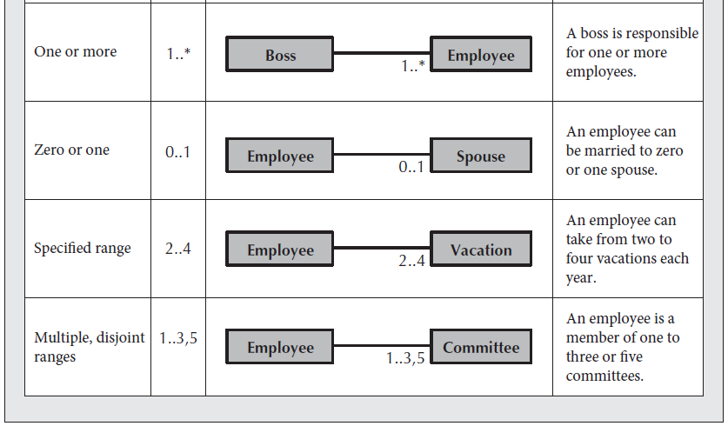
Class Diagram
A. Dennis et al.,(2015). Systems Analysis and Design An Object-Oriented Approach with UML, 5th ed. ISBN: 978-1-118-80467-4

Slide 36
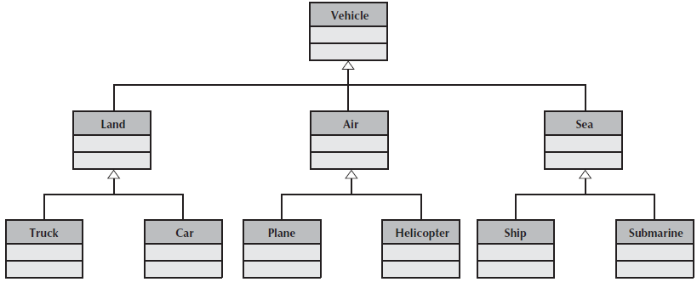
Class Diagram
Generalization and Aggregation
generalization association shows that one class (subclass) inherits from another class (superclass), meaning that the properties and operations of the superclass are also valid for objects of the subclass
examples of generalization are:
Cardinal is a-kind-of Bird, which is a-kind-of Animal
a Truck is a-kind-of Land Vehicle, which is a-kind-of Vehicle

Slide 37
Creating Structural Model using CRC Cards
Create CRC Cards
Review CRC Cards
to determine if additional candidate objects, attributes, operations, and relationships are missing
Role Play the CRC Cards
This step allows you to identify other objects, attributes, operations, or relationships
Create Class Diagrams
Review Class Diagram
Incorporate Patterns
incorporate useful patterns into the evolving structural model
Review the Model
A. Dennis et al.,(2015). Systems Analysis and Design An Object-Oriented Approach with UML, 5th ed. ISBN: 978-1-118-80467-4

Slide 38
References
Alan Dennis, Barbara Haley Wixom, David Tegarden (2015). Systems Analysis and Design_ An Object-Oriented Approach with UML, 5th ed. ISBN: 978-1-118-80467-4

